Slide 1
OASIS: dynamic pricing
Webinar

Slide 2

Introduction
Valmont data can now integrate with OASIS quoting and ordering software.
With this integration, you can now quickly and efficiently search for Valmont products and receive their available pricing levels.
This presentation will show you how to set Valmont as a Manufacturer and explain the dynamic pricing feature.
The OASIS/Valmont wiki can be found here: OASIS Wiki

Slide 3
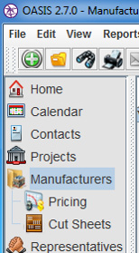
OASIS
Manufacturer
Set up Valmont as a manufacturer
1 - Go to Manufactures screen
2 - Click the ‘Add New’ button
2
1

Slide 4
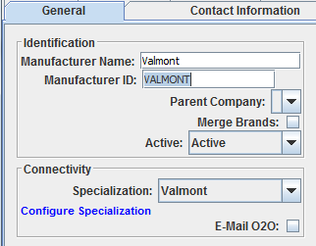
OASIS
Manufacturer
1 - Enter a ‘Manufacturer Name’ and ‘Manufacturer ID’
  This is for internal reference only and will not affect how the manufacturer is set up
  We recommend Valmont, Valmont Structures, or Valmont Poles
2 - Under ‘Connectivity’, choose Valmont as the Specialization
3 – Click on ‘Configure Specialization’
1
3
2

Slide 5
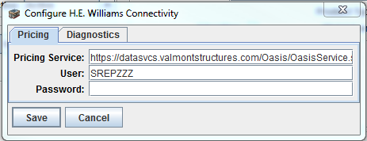
OASIS
Manufacturer
1 – Enter the Price Service URL below
https://datasvcs.valmontstructures.com/Oasis/OasisService.svc
2 – Enter your Valmont Sales Web Username and Password
3 – Click ‘Save’ and then ‘Save and Close’
1
2
3

Slide 6
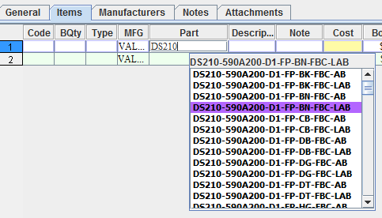
OASIS
Dynamic Pricing
On a quote or order line, select Valmont as the manufacturer
In the ‘Part’ tab, begin entering a Valmont Catalog Number (ex: DS210-)
Utilize auto-complete to select a valid Valmont Catalog Number
Pricing will populate

Slide 7
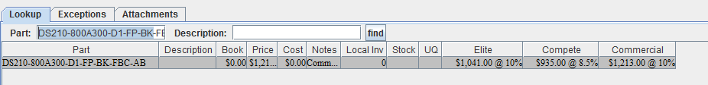
OASIS
Dynamic Pricing
Use the right mouse button to select ‘Price Lookup’, to select different pricing levels if available (ex. Elite, Compete, Commercial)
Right click here

Slide 8
OASIS
Additional Notes
Pricing is updated weekly on Sundays
  You may experience slower than normal loading times after updates. The information is then cached, and will be faster the more you use the software
As of 8/1/17, only steel pricing is available in OASIS
You will be notified of updates and additions to future OASIS/Valmont rollouts
The OASIS/Valmont wiki can be found here: OASIS Wiki

Slide 9
THANK YOU!
valmontstructures.com

